Slide 1
MACHINE
LEARNING

Slide 2

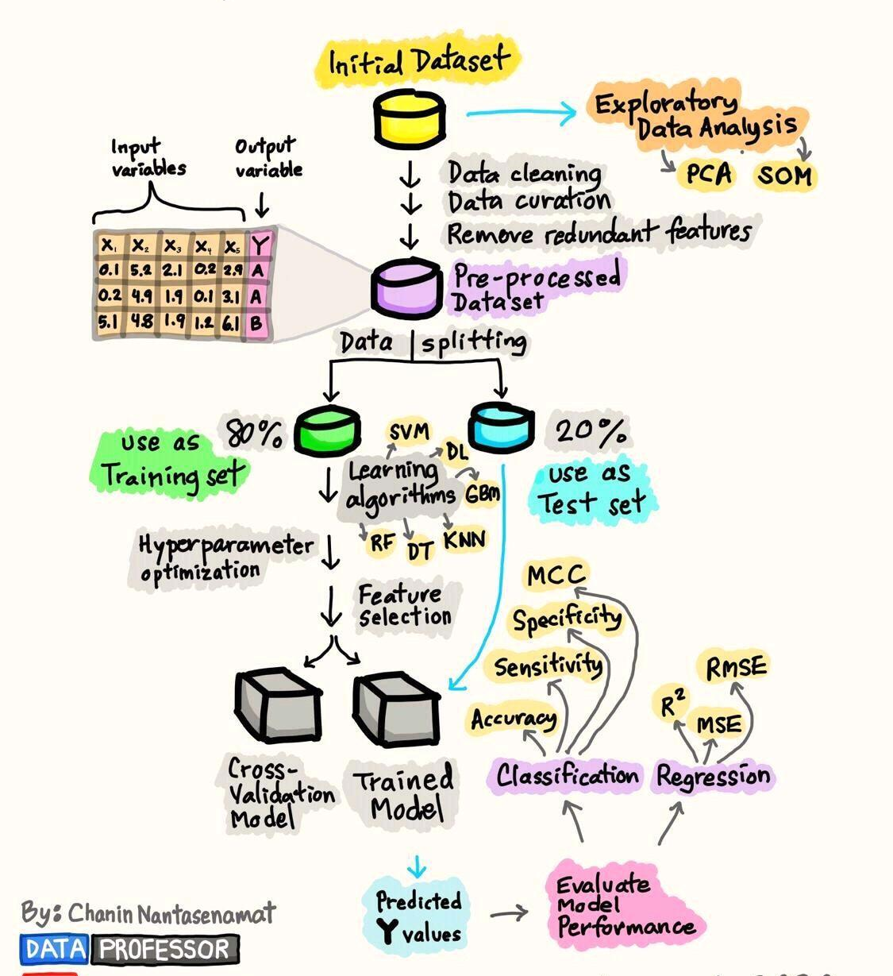


1. THE process

Slide 3



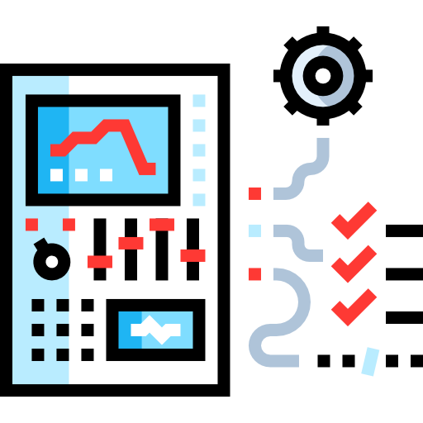



Steps
Data Collection
Model Selection
Model Training
Evaluation
Parameter Tuning
Data Pre-processing
Model Deployment

Slide 4





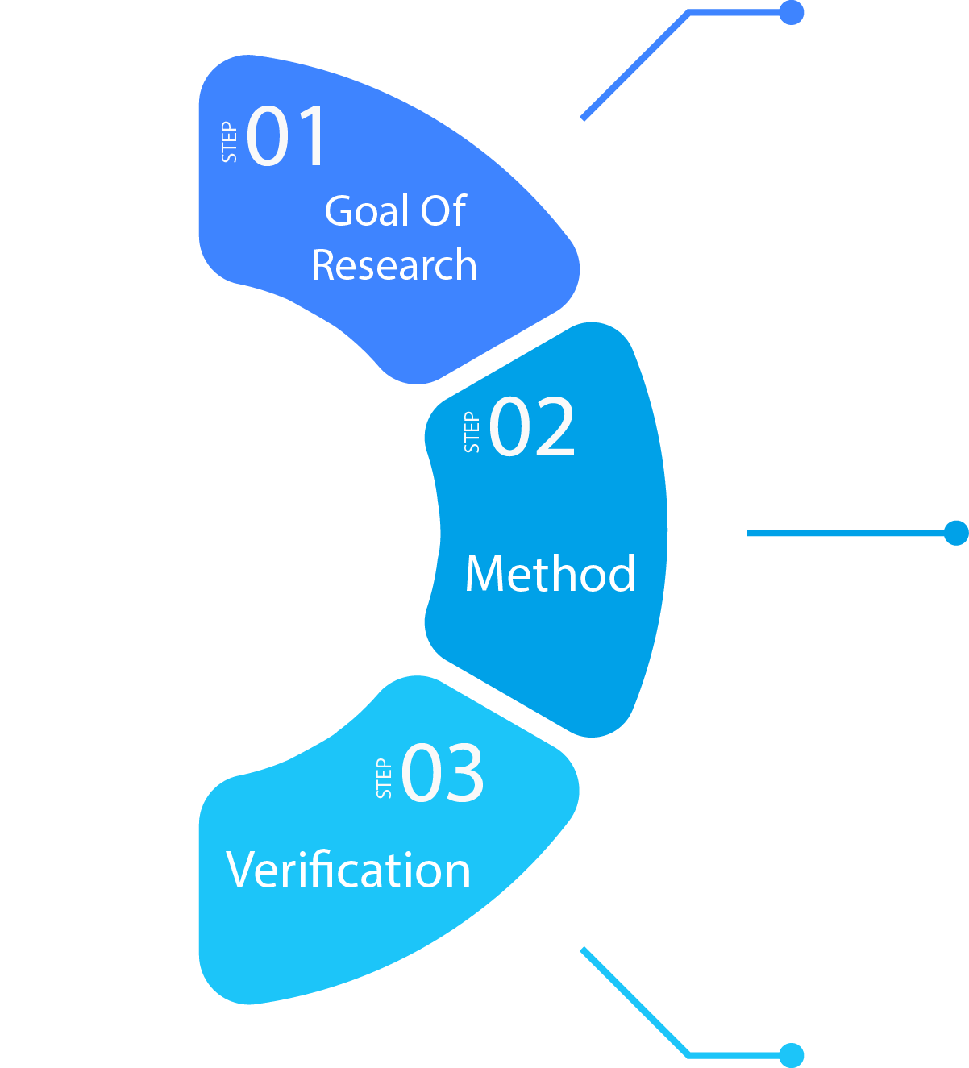







Agriculture
Rainfall data
Temperature data etc.
Crime
cctv images & videos
Forensic data
Education
Administrative data
Performance data
Healthcare
Billing and claims record
Clinical trials data
IoT Sensors
Social Media Tracking
Surveys
Online Tracking
Verify data source
Check validity and reliability

Slide 5

2. DATA PRE-PROCESSING

Slide 6
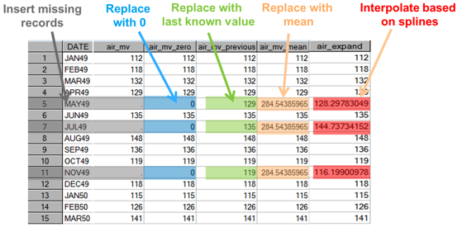
1. Impute Missing Values :
Figure 1
Tools:
R, Python pandas etc

Slide 7
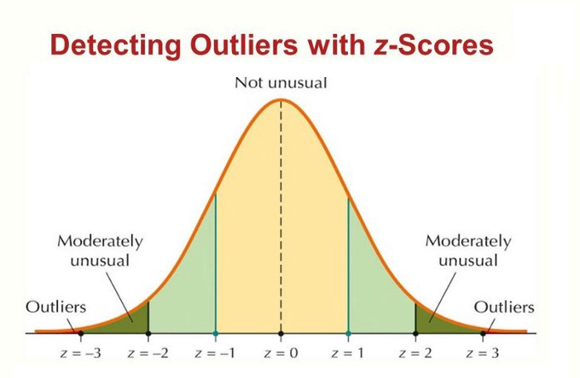
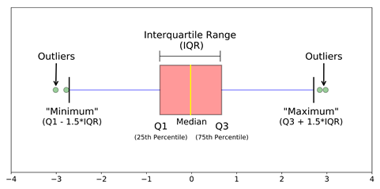
2. Handle Outliers:
Detect:
Figure 2
Figure 3
Handle:
Quantile based flooring or capping / Remove
Mean or Median imputation / Remove

Slide 8
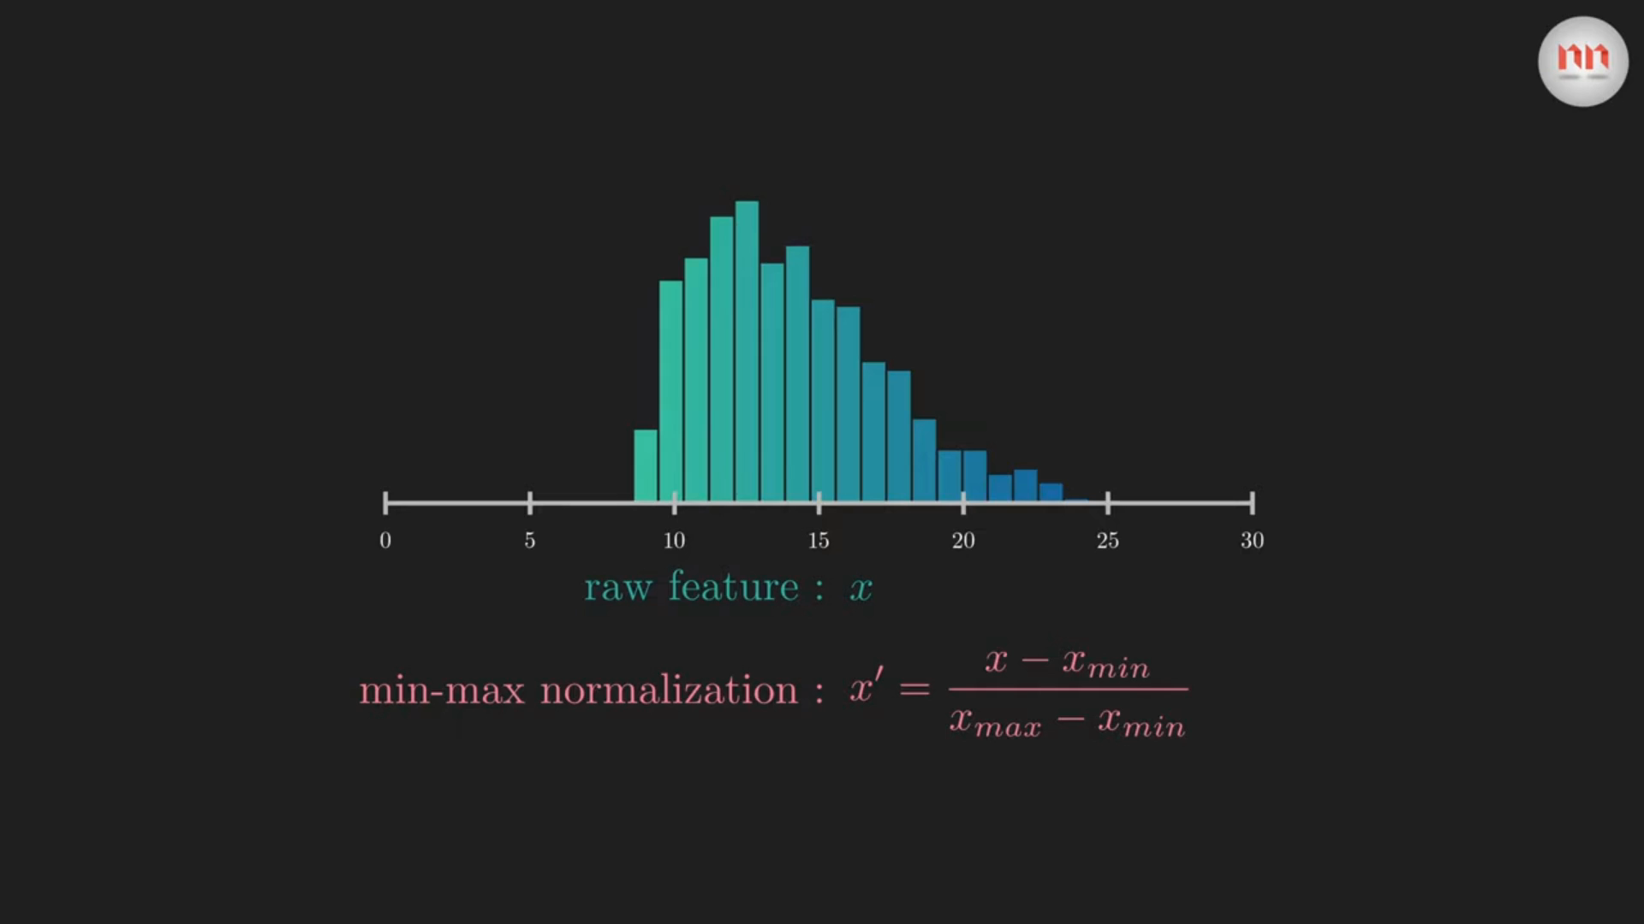
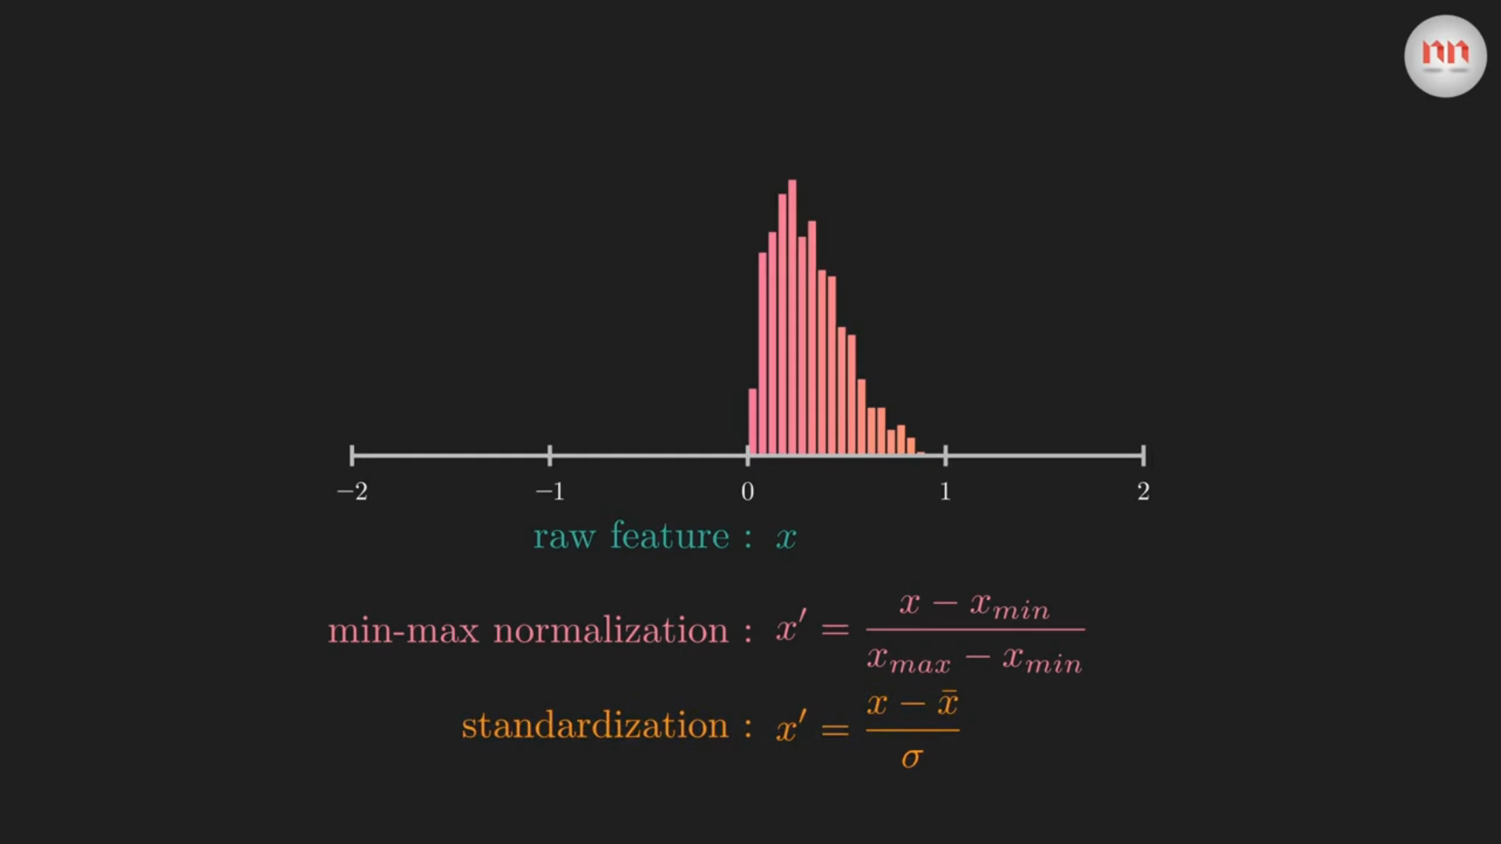
3. Scale Features
For:
Distance based algorithms
Gradient descent based algorithms
Ways:
Standardization
Normalization
Clip 1
Clip 2

Slide 9
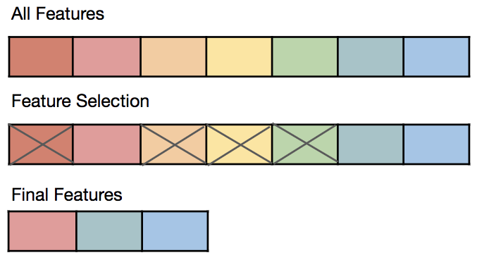
4. Select Features
To
Reduce Dimensionality
Reduce overfitting
Reduce training time
Ways
PCA
Univariate feature selection
Correlation based feature selection
Figure 4

Slide 10
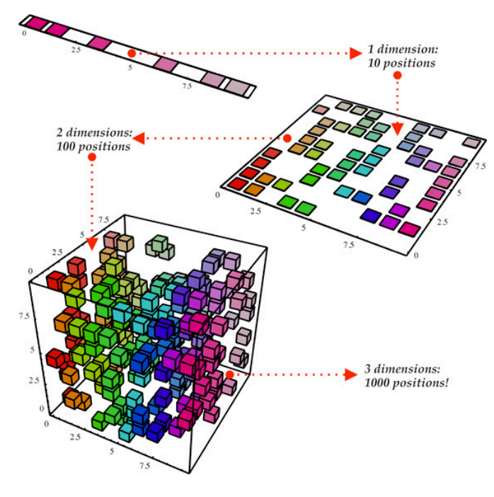
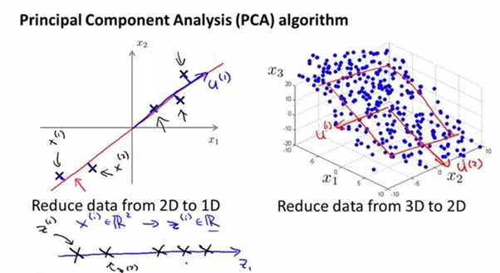
Dimensionality Reduction
Principle Component Analysis
Figure 6
Figure 5

Slide 11
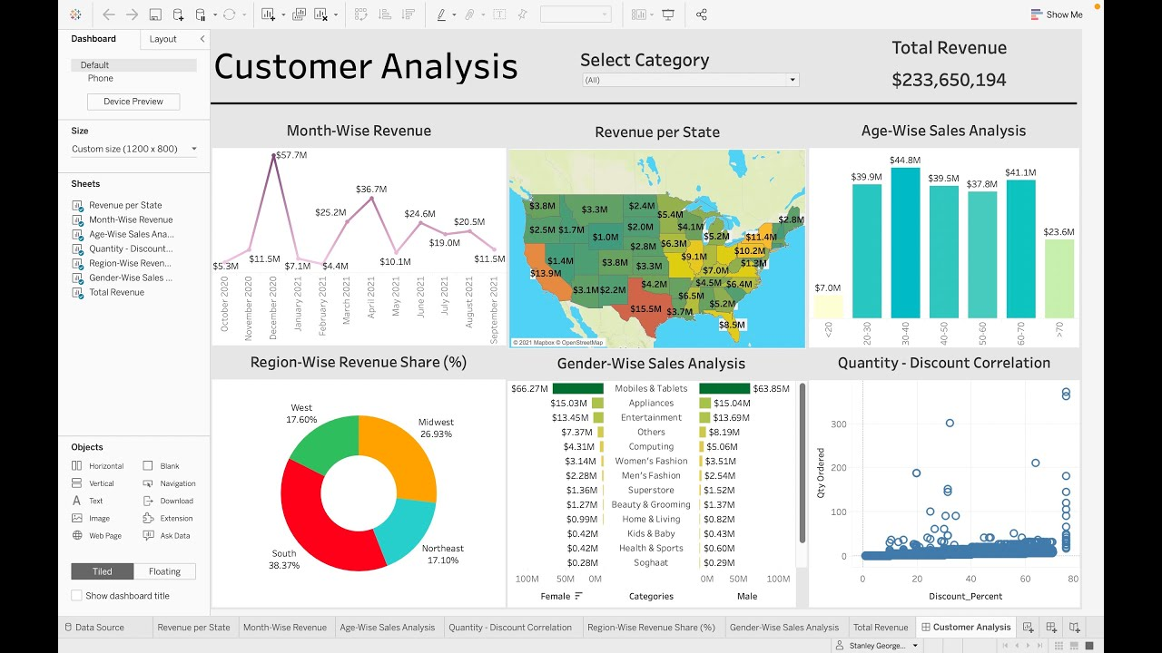
5. Visualize
Figure 7

Slide 12

3. MODEL SELECTION

Slide 13

Identify problem type:
Classification
Prediction
Size and Complexity:
Greater – Choose complex models
Lesser – Choose simple models
Interpretability:
Outputs should be easier to understand

Slide 14

4. MODEL
TRAINING

Slide 15





Iterative Process
Use the model on the training data
Decrease errors and increase accuracy
Train-test split the data
Evaluate the model
Steps

Slide 16

5. MODEL EVALUATION

Slide 17
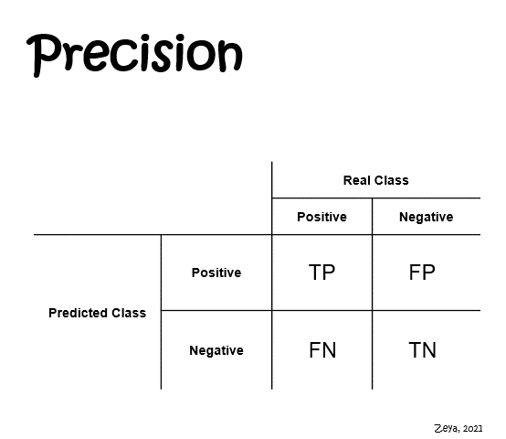
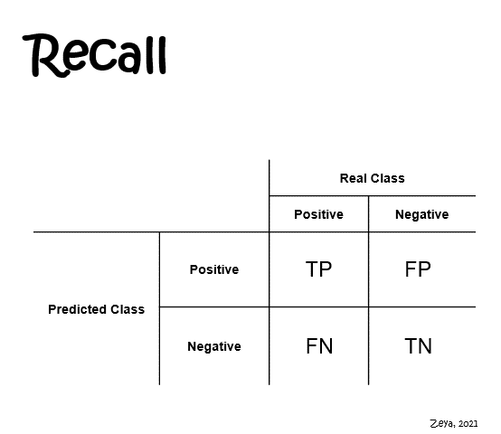
Accuracy, Precision and Recall
Accuracy = No. of correct predictions (TP + TN)
Total no. of predictions (TP + TN + FP + FN)
Clip 3
Clip 4

Slide 18
2. F1 score
It is the harmonic mean of precision and recall, providing a balanced evaluation of a model's performance.
In simple terms, the F1 score tells us how well a model performs in correctly identifying positive instances while avoiding false positives
F1 score = 2 * Precision * Recall
Precision + Recall

Slide 19
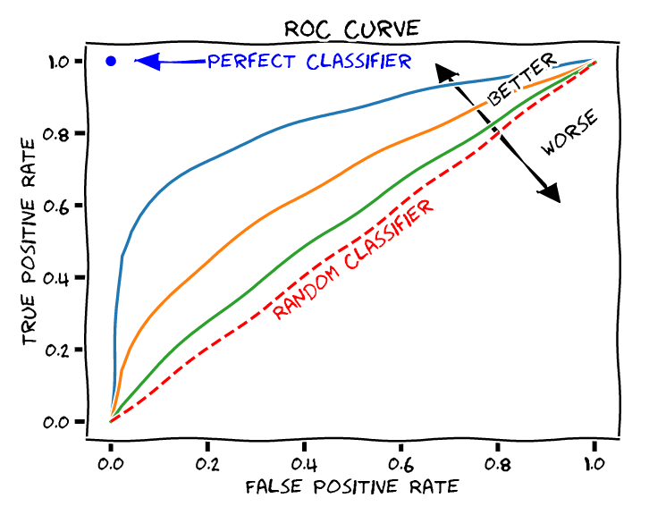
3. AUC – ROC Curve
Area under curve of Receiver operating characteristic curve
Hence greater the area under the curve, better the model’s performance
Figure 8

Slide 20
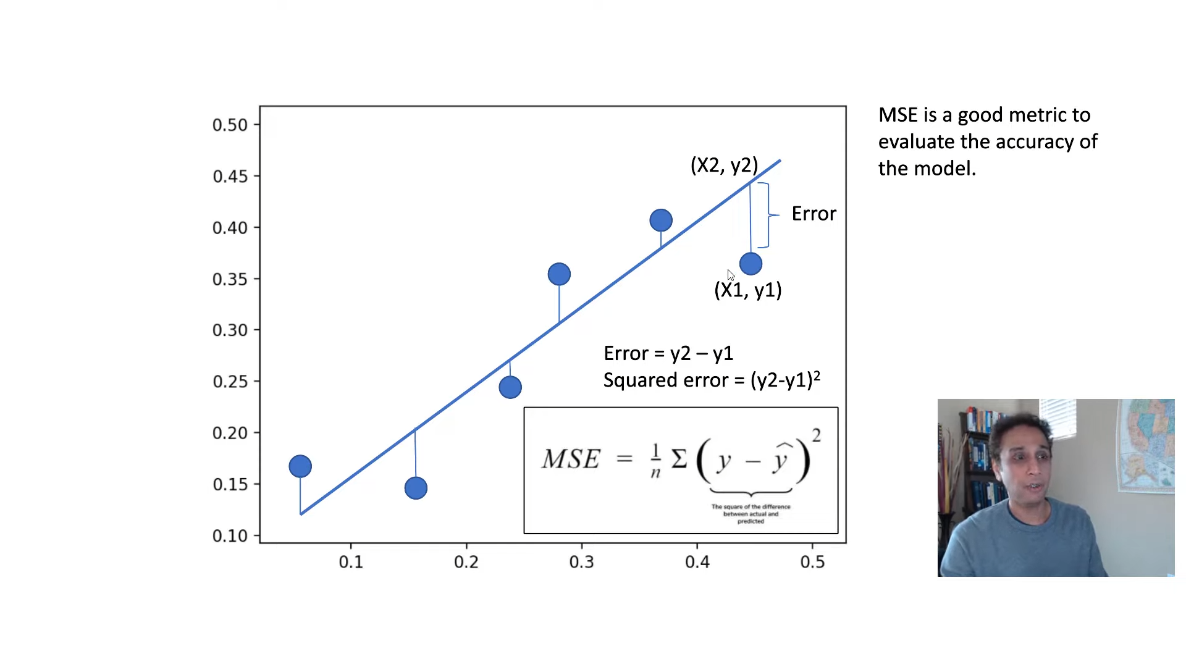
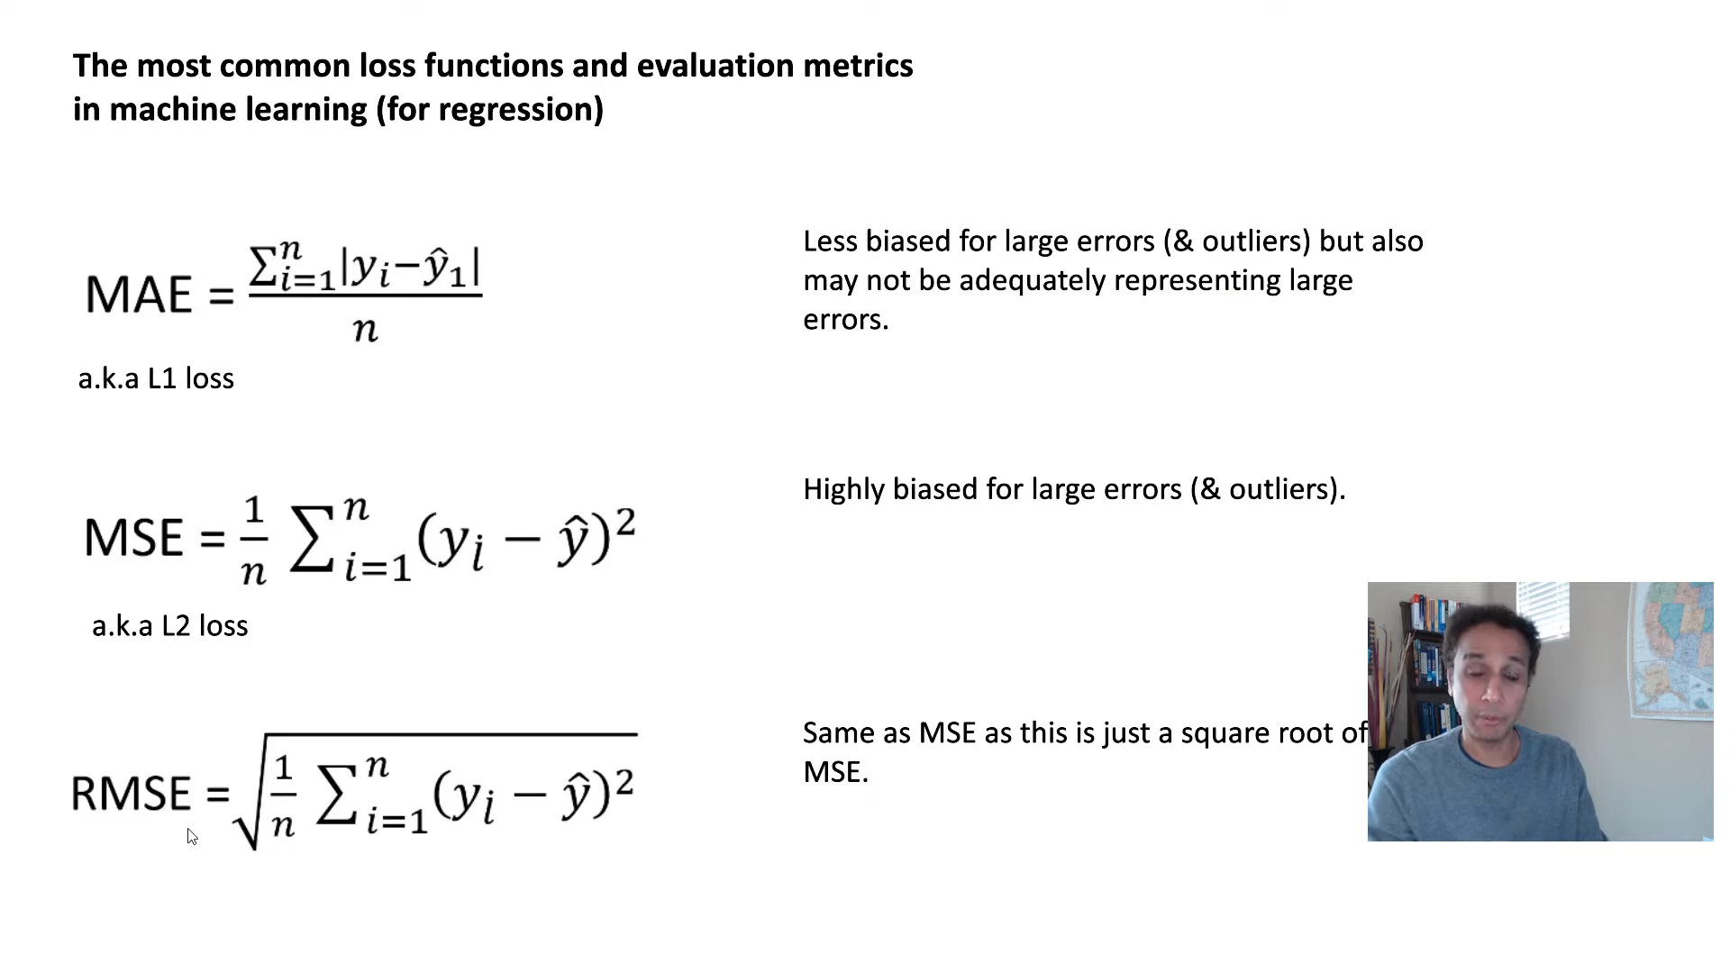
c
Mean absolute error, Mean squared error and Root mean squared error
Figure 9
Figure 10

Slide 21
2. R² Score and Adjusted R²
R² = 1 − sum squared regression (SSR)
R-squared tells us how well the independent variables in a regression model explain the variation in the dependent variable
total sum of squares (SST)
= 1 − ∑(actual y_{i} – predicted y_{i})²
∑(actual y_{i} – mean(y_{i}))²
R² _{adj} = 1 − (1 − R²)(n − 1)
Adjusted R-squared (adjusted R^2) is a modified version of R-squared that takes into account the number of independent variables and the sample size
(n – k – 1)
Where n = no. of points in data
k = no. of independent regressors

Slide 22
For Regression
Mean absolute error
Root mean squared error
For Classification
Accuracy score
Precision and Recall
Mean squared error
R - squared
Adjusted R - squared
Confusion matrix
F1 – score
AUC – ROC Curve
EVALUATION
TECHNIQUES

Slide 23

6. PARAMETER
TUNING

Slide 24
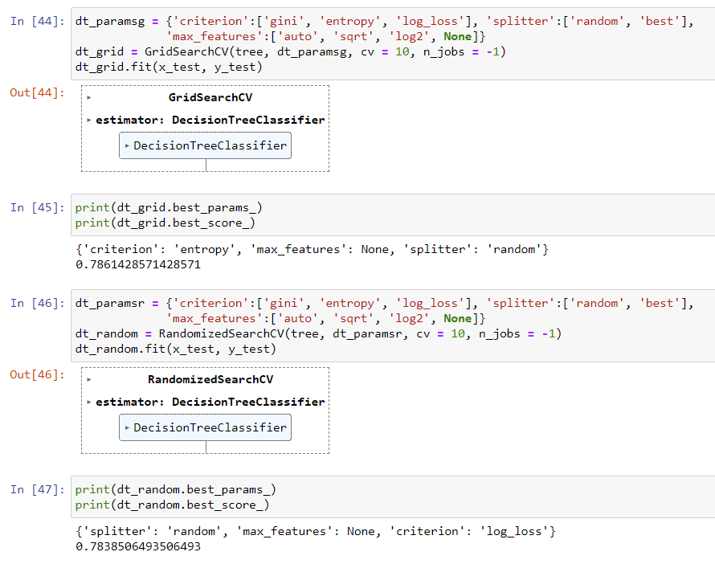
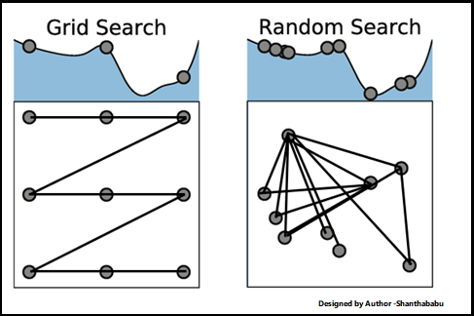
Grid Search and Random search
Figure 11

Slide 25
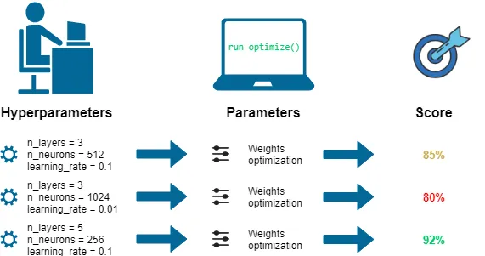
Hyperparameter Tuning or Optimizations for more complex algorithms
Figure 12

Slide 26
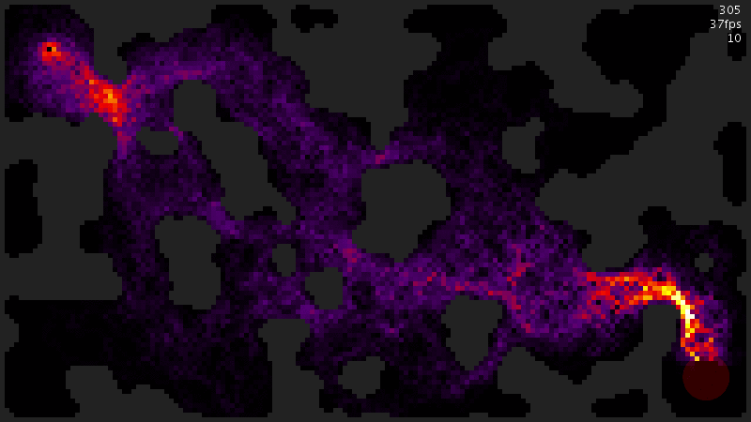
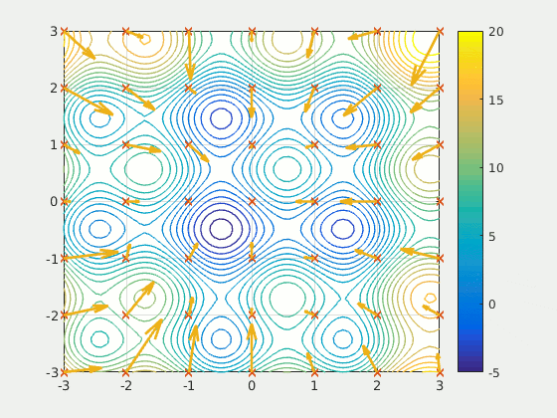
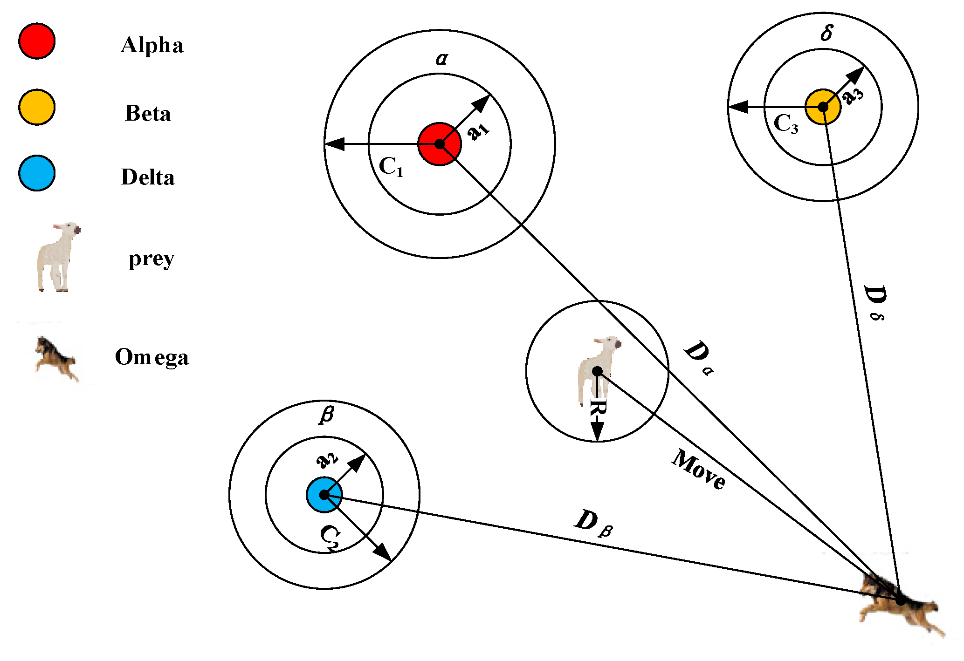
Optimization Techniques:
Ant colony optimization
Grey wolf optimization
Particle swarm optimization
Figure 13
Figure 15
Figure 14

Slide 27

7. MODEL
DEPLOYMENT

Slide 28
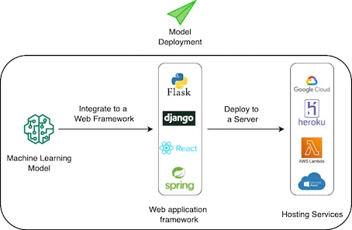
Machine Learning Model Deployment:

Slide 29
REFERENCES
Figure 1: https://pubsonline.informs.org/do/10.1287/LYTX.2014.01.05/full/impute.png
Figure 2: https://editor.analyticsvidhya.com/uploads/39536outlierdetection.png
Figure 3: https://editor.analyticsvidhya.com/uploads/12311IQR.png
Figure 4: https://miro.medium.com/max/694/0*gz5XuPZfN0wAi66I
Figure 5: https://d33wubrfki0l68.cloudfront.net/01316408b30cff093b186ee7194637d793e62f27/309a4/images/dimensionality-reduction-1.png
Figure 6: https://miro.medium.com/v2/resize:fit:750/format:webp/1*T3Jijdtg0lcS3pP4ZFaMkw.png
Figure 7: https://i.ytimg.com/vi/_qReGTOrKTk/maxresdefault.jpg
Figure 8: https://sefiks.com/2020/12/10/a-gentle-introduction-to-roc-curve-and-auc/
Figure 9: https://youtu.be/fk7bzKFDmk8
Figure 10: https://youtu.be/fk7bzKFDmk8

Slide 30
Figure 11: https://www.analyticsvidhya.com/blog/2022/02/a-comprehensive-guide-on-hyperparameter-tuning-and-its-techniques/
Figure 12: https://towardsdatascience.com/hyperparameters-optimization-526348bb8e2d
Figure 13: https://github.com/reaxis/ants
Figure 14: https://www.mdpi.com/2073-8994/11/12/1470
Figure 15: https://commons.wikimedia.org/wiki/File:ParticleSwarmArrowsAnimation.gif
Figure 16: https://towardsdatascience.com/deploying-machine-learning-models-with-heroku-4dec1df87f71
Clip 1: https://youtu.be/sxEqtjLC0aM
Clip 2: https://youtu.be/sxEqtjLC0aM
Clip 3: https://towardsdatascience.com/precision-and-recall-made-simple-afb5e098970f
Clip 4: https://towardsdatascience.com/precision-and-recall-made-simple-afb5e098970f

